Slide 1
Introduction to Entity Framework
Content Developed by Kaushik Natua
Senior Corporate .NET Consultant
13 years experience

Slide 2
Objectives
What is Entity Framework
Why use Entity Framework
Different types of workflow in Entity Framework
Versions of Entity Framework

Slide 3
What is Entity Framework
Entity Framework is an ORM Framework. ORM stands for Object Relational Mapping.
ORM framework automatically creates classes based on database tables, and the vice-versa is also true, it is it can also automatically generate necessary SQl to create database tables based on the code classes.

Slide 4
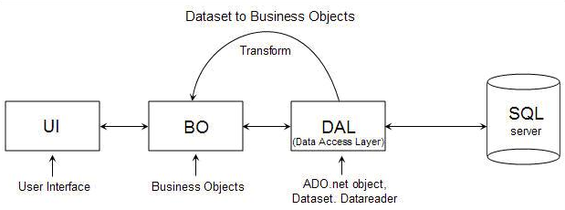
Why use Entity Framework
Let us understand now why use Entity Framework when we has traditional persistent frameworks like ADO.NET.
Prior to .NET 3.5, we (developers) often used to write ADO.NET code or Enterprise Data Access Block to save or retrieve application data from the underlying database.
We used to open a connection to the database, create a DataSet to fetch or submit the data to the database, convert data from the DataSet to .NET objects or vice-versa to apply business rules.
This was a cumbersome and error prone process.

Slide 5
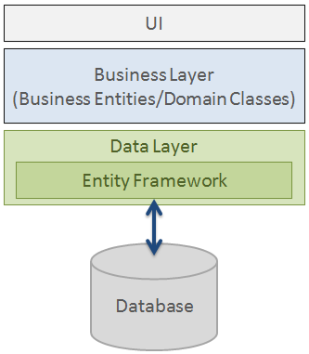
Why use Entity Framework
Microsoft has provided a framework called "Entity Framework" to automate all these database related activities for your application.
Entity Framework is an object-relational mapper (O/RM) that enables .NET developers to work with a database using .NET objects. It eliminates the need for most of the data-access code that developers usually need to write.

Slide 6
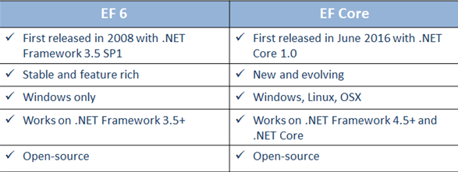
Entity Framework Versions
Microsoft introduced Entity Framework in 2008 with .NET Framework 3.5. Since then, it released many versions of Entity Framework. Currently, there are two latest versions of Entity Framework: EF 6 and EF Core.

Slide 7
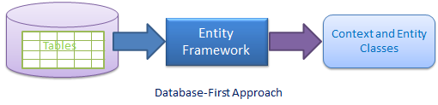
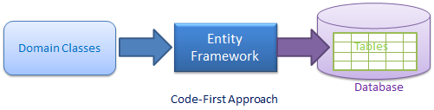
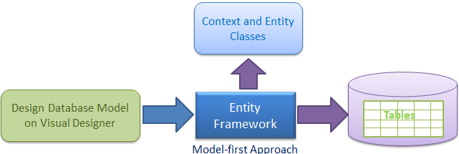
Development Approaches with Entity Framework
There are three different approaches you can use while developing your application using Entity Framework:
Database-First
Code-First
Model-First

Slide 8
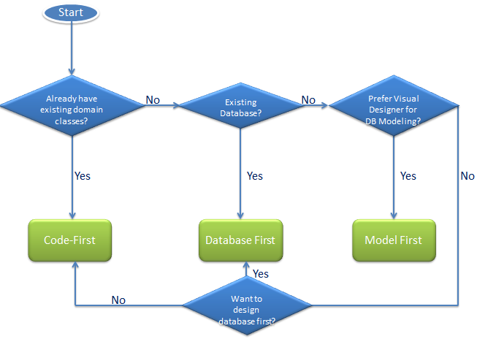
Choosing the Development Approach for Your Application

